Slide 1
Bangladesh ODI Cricket Prediction
Group Members:
Md Rakibul Islam (15255017)
Md Zahidul Islam (143010400023)
submitted to:
Md Mynoddin (Lecturer of UITS , Dept-IT)

Slide 2
Overview
Abstract
Introduction
Related Work
ODI Statistics of Bangladesh
Working Approach
Modeling
Algorithm
Result
Conclusion

Slide 3
Abstract
In this article a model is proposed for Bangladesh national team to predict win or loss in a match using data mining and machine learning approach & will be discuss about few others research paper. This model is just for one day international (ODI) cricket match. This model is applied using Linear Regression Classifier and Naïve Bays Classifier, Random forest etc.

Slide 4
Introduction
The Bangladesh National cricket team is representing Bangladesh. The team is administered by the Bangladesh Cricket Board (BCB).
We embark on predicting the outcome of a One Day International (ODI) cricket match using a Data mining & Machine learning approach
Modeling the team strength boils down to modeling individual players batting and bowling performances, forming the basis of our approach.

Slide 5
Related Work
Duckworth and Lewis proposed a solution, called the D/L method.
Considers the strength of opponent team, along with other factors, in modeling the performance of batsmen and bowlers.
However, like in any sport, winning is the ultimate goal in cricket.
studied the role of multiple factors including home advantage, toss, match type (day or day and night), competing teams, venue familiarity, and season, etc. and applied Support Vector Machines(SVM) and NaïveBayes Classifiers for predicting the winner of a match.

Slide 6
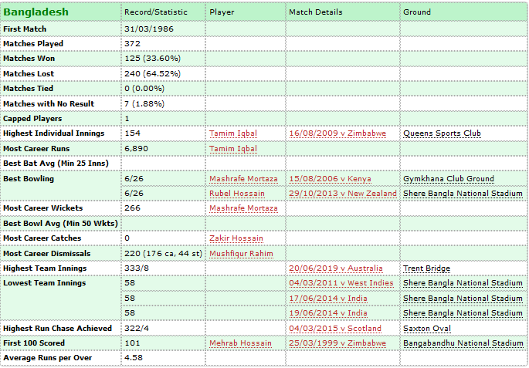
ODI Statistics of Bangladesh

Slide 7
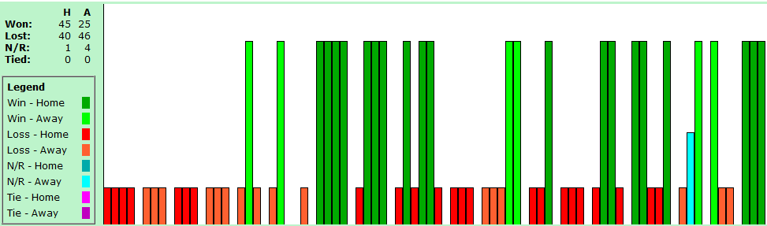
ODI Statistics of Bangladesh

Slide 8
ODI Statistics of Bangladesh

Slide 9
Working Approach
Training Data Model
Testing Data Model
Machine Learning Algorithm
Classifier
Predicting

Slide 10
Modeling
Training Data: Training data, also called AI training data, training set, training dataset, or learning set — is the information used to train an algorithm. The training data includes both input data and the corresponding expected output.
Testing Data: Testing data, on the other hand, includes only input data, not the corresponding expected output. The testing data is used to assess how well your algorithm was trained, and to estimate model properties.

Slide 11
Algorithms
SVM: A Support Vector Machine (SVM) is a discriminative classifier formally defined by a separating hyper plane. In other words, given labeled training data (supervised learning), the algorithm outputs an optimal hyper plane which categorizes new examples.
Random Forest: Random forest classifier creates a set of decision trees from randomly selected subset of training set. It then aggregates the votes from different decision trees to decide the final class of the test object.

Slide 12
Logistic Regression: Logistic regression is another technique borrowed by machine learning from the field of statistic. It is the go-to method for binary classification problems.
Decision Trees: Decision Tree Classifier is a simple and widely used classification technique. It applies a straightforward idea to solve the classification problem

Slide 13
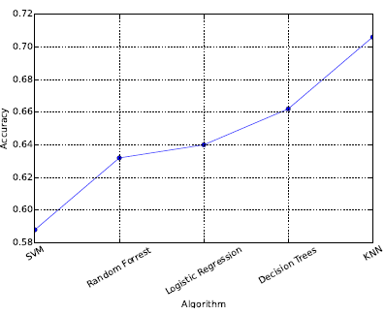
Result

Slide 14
Conclusion
It has been showed that Bangladesh Cricket Team is improving their performance day by day. From 1977 to right now they are trying to develop their technique to play and also to work on their lacking.
The paper addresses the problem of predicting the outcome of an ODI cricket match using the statistics of 100 matches.
We observe that simple features can yield very promising results.

Slide 15
Thank You

